Slide 1
Time to Cache it- A Distributed Cache
Azure Redis Cache is a distributed, in-memory, managed cache that helps you build highly scalable and responsive applications, by providing you with fast access to your data. It’s based on the popular open source Redis Cache (http://redis.io/), and it gives you access to a secured, dedicated Redis cache that’s managed by Microsoft.
Notes:
Azure Redis Cache is a distributed, in-memory, managed cache that helps you build highly scalable and responsive applications, by providing you with fast access to your data. It’s based on the popular open source Redis Cache (http://redis.io/), and it gives you access to a secured, dedicated Redis cache that’s managed by Microsoft.

Slide 2
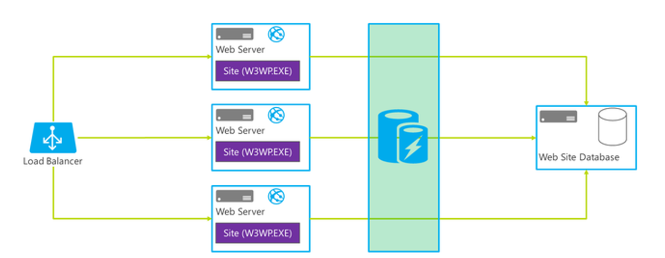
Time to Cache it- A Distributed Cache

Slide 3
Features
High performance: Helps your application become more responsive, even as user load increases, and leverages the low-latency, high-throughput capabilities of the Redis engine.
This separate distributed cache layer allows your data tier to scale independently for more efficient use of compute resources in your application layer.

Slide 4
Features
Easy to use and manage: Provision Redis cache using the Azure Preview portal. You can use Redis from most programming languages used today. Easily manage and monitor health and performance in the Azure Preview portal. Let Microsoft manage replication of the cache for increased availability.
Great features: Redis is an advanced key-value store, where keys can contain data structures. Redis supports a set of atomic operations on these data types, and it supports master/subordinate replication, with fast non-blocking first synchronization, auto-reconnection on net split, and more. Other features include transactions, Pub/Sub, Lua scripting, and keys with a limited time to live.

Slide 5
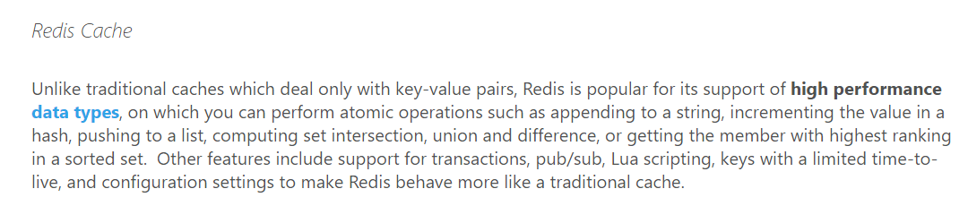
Redis over others

Slide 6
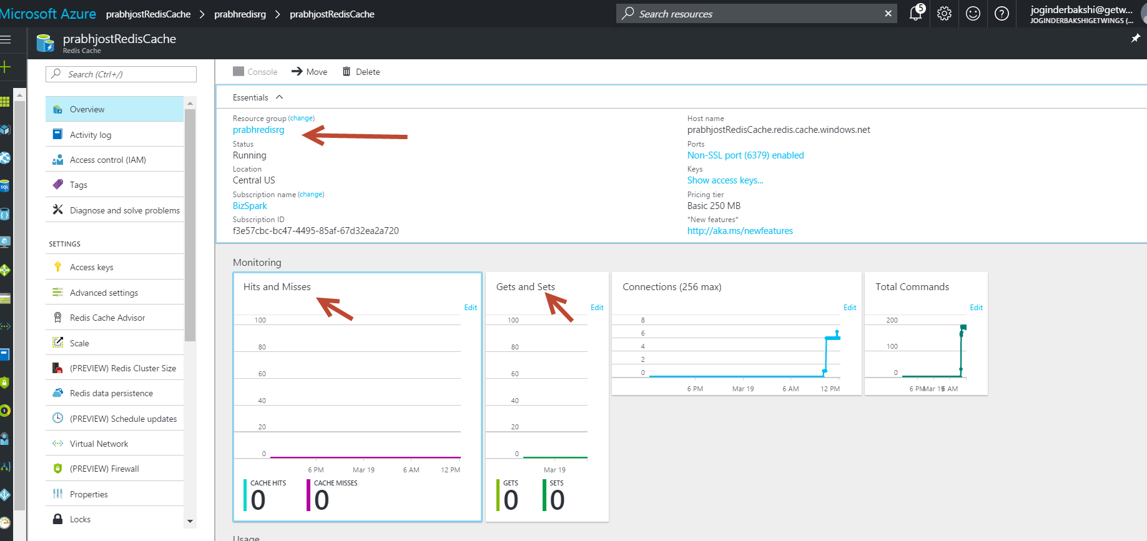

Slide 7
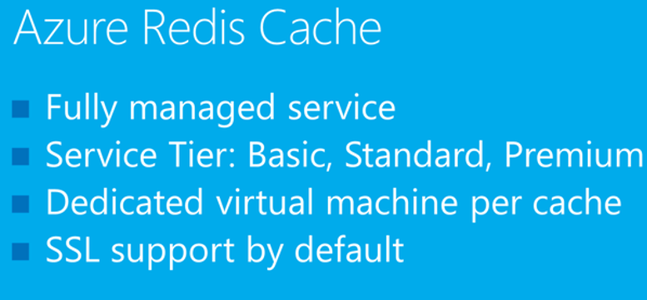
Notes:
Azure Redis Cache gives you the ability to use a secure open source Redis cache. It is a dedicated offering managed by Microsoft, to build highly scalable and responsive applications by providing you super-fast access to your data. You also get to leverage the rich feature set and ecosystem provided by Redis while also getting reliable hosting and monitoring from Microsoft.
Basic—Single node, multiple sizes, ideal for development/test and non-critical workloads. The basic tier has no SLA.
Standard—A replicated cache in a two node Primary/Secondary configuration managed by Microsoft, with a high availability SLA.
Premium—The new Premium tier includes a high availability SLA and all the Standard-tier features and more, such as better performance over Basic or Standard-tier Caches, bigger workloads, disaster recovery, and enhanced security. Additional features include: persistence, clustering and VNET support.

Slide 8
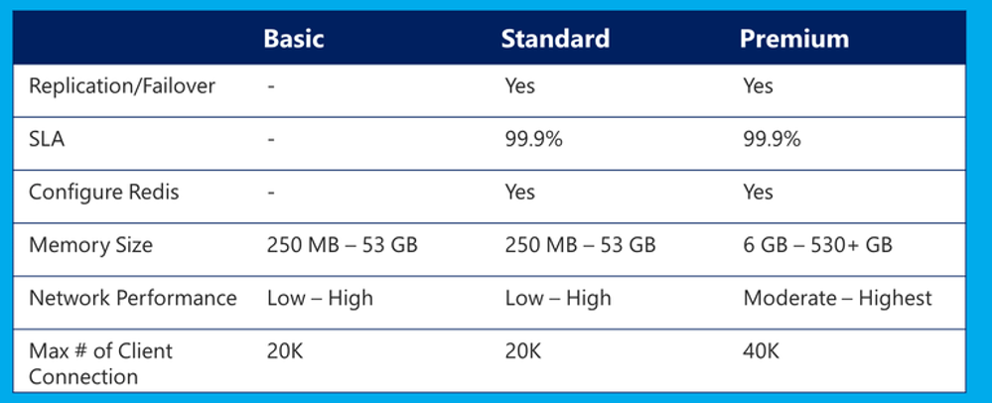
Notes:
Service tiers can be used for caching.
Service Level Agreement (SLA): Azure Redis Cache guarantees that a Standard / Premium cache will be available at least 99.9% of the time. SLA only covers connectivity to the Cache endpoints. The SLA does not cover protection from data loss. We recommend using Redis data persistence feature in the Premium tier to increase resiliency against data loss.
Configure Redis: Keyspace notifications etc.
In premium tier, more cache size (>530 is available) upon request.

Slide 9
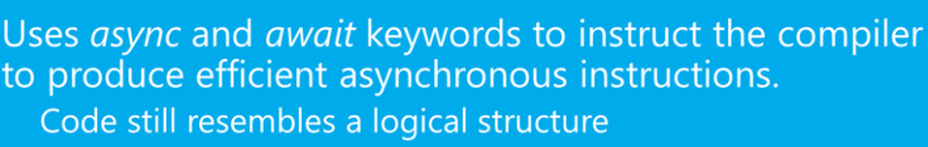
Async Is the way to go…..

Slide 10
Effective immediately, CloudMonix now supports monitoring of Azure Redis Cache, alerting when outages occur, performance drops, hit rates become ineffective, slave servers are not synchronized properly, and more.
Azure Redis Cache gives you access to a secure, dedicated Redis Cache instance, managed by Microsoft, and is accessible from any application within Azure.

Slide 11
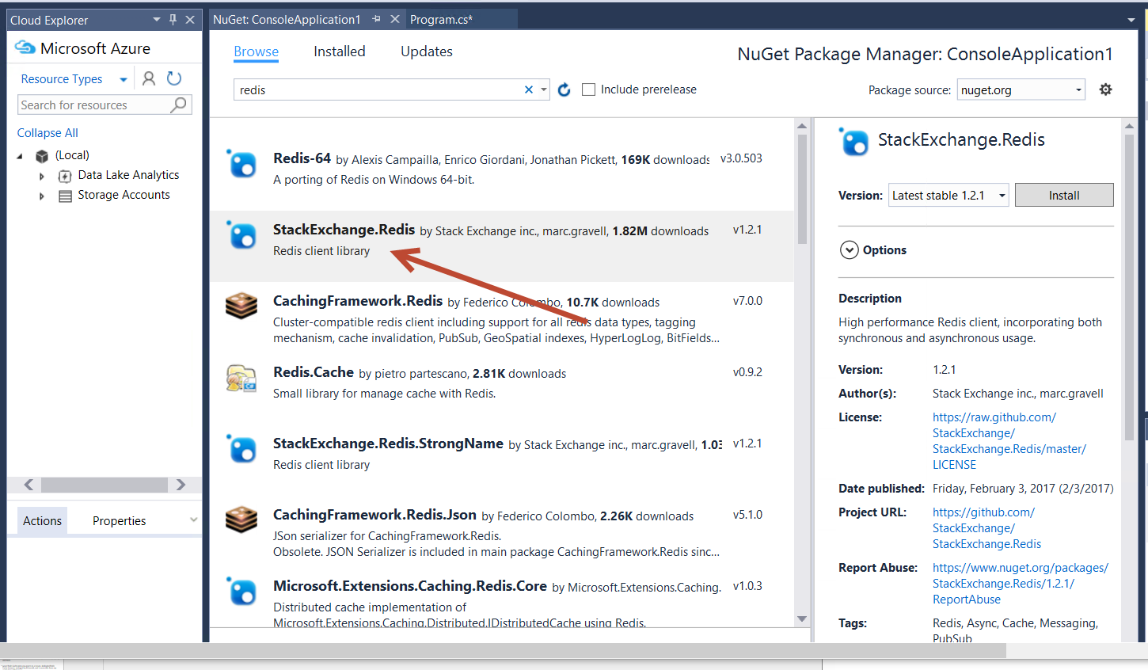

Slide 12
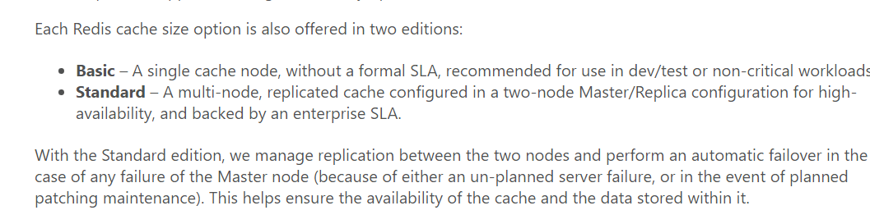

Slide 13
